Slide 1

StrataGraft
Design Review Case Study
Ashira Bindels

Slide 2
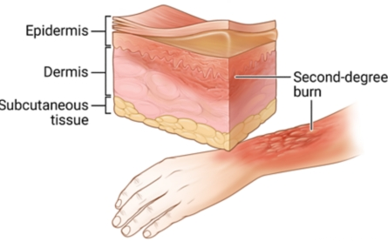
Problem Description- Burns
Consequences: dehydration, bacterial infection, disfigurement and long-term disability
~180,000 deaths annually
~ 40,000 people/year hospitalized in US
Cost in US: >$211 million
“Burns.” World Health Organization, World Health Organization, https://www.who.int/news-room/fact-sheets/detail/burns.

Slide 3
Available Solutions
Existing Solution | Advantage | Disadvantage
Surgical excision and skin grafting | Low risk of immune response as the donor is also the recipient | creation of secondary wound
Keratin biomaterial hydrogels | Does not require autograft Helps epithelial growth | Only tested in swine models
Epicel | Rapid wound closure | Only used if total body burnt surface area ≥30%
Integra | Long shelf life up to 2 years Good aesthetic results | two step procedure: re-epithelization and autograft of epidermal layer
PermaDerm | Autologous Large number of grafts can be created from a small piece of patient’s skin | Need to harvest patient’s own skin and expand these cells

Slide 4
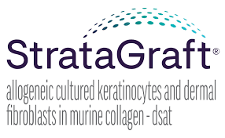
StrataGraft - Introduction
Stratatech Corporation (Mallinckrodt Pharmaceuticals)
Approved by FDA: 15 June 2021
Treatment of deep partial thickness burns

Slide 5
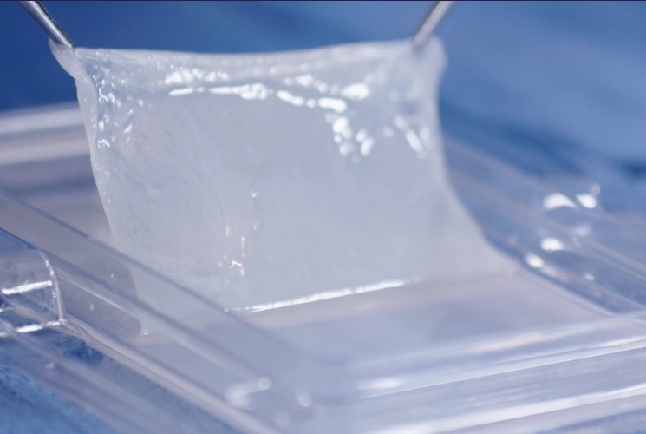
StrataGraft - Composition
2 types of human skin cells
Keratinocytes
Dermal fibroblasts contained within gelled collagen

Slide 6
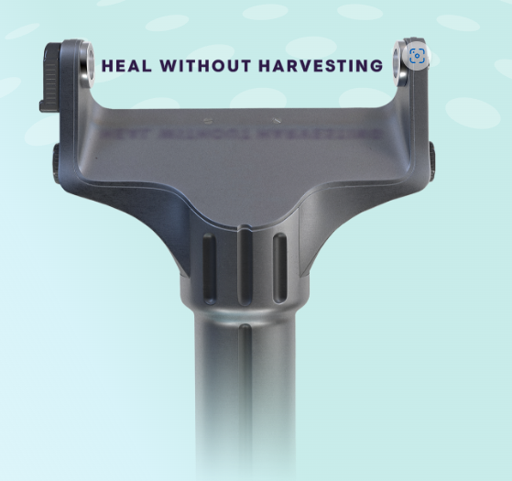
StrataGraft – how it works
Applied to burnt area by healthcare provider
Biodegradable over 3 months
Different sizes available

Slide 7
StrataGraft - Evidence
Durable wound closure
Equal or reduced scarring compared to autografting
Biocompatible
Biodegradable
Reduced need for autografting
1
2
3
4
4
5
5

Slide 8
Conclusion
Efficacious solution for treatment of deep partial thickness burns
Reduces the need for autografting
Provides durable wound closure by 3 months

Slide 9
References
World Health Organization (2018) Burns. Accessed from: https://www.who.int/news-room/fact-sheets/detail/burns
UVA Health. Skin Graft. (2002) Accessed from: https://uvahealth.com/services/plastic-surgery/skin-graft
Poranki D, Goodwin C, Van Dyke M. Assessment of Deep Partial Thickness Burn Treatment with Keratin Biomaterial Hydrogels in a Swine Model. Biomed Res Int. 2016;2016:1803912. doi: 10.1155/2016/1803912. Epub 2016 Nov 29. PMID: 28025638; PMCID: PMC5153489.
Vericel Corporation. (2022) Using Epicel. Accessed from: https://www.epicel.com/treatment-with-epicel.html
Dhasmana, et.al. (2018) Skin Tissue Engineering: Principles and Advances. Journal of Dermatology and Skin care. Accessed from: Skin-Tissue-Engineering- Principles-and-Advances.phttp://article.scholarena.co/Skin-Tissue-Engineering-Principles-and-Advances.pdfdf (scholarena.co)
Integra LifeSciences. (2022) Integra Dermal Regeneration Template.
Accessed from: https://www.integralife.com/integra-dermal-regeneration-template/product/wound-reconstruction-care-inpatient-acute-or-integra-dermal-regeneration-template
Regenicin. About Regenicin. Accessed frim: http://www.regenicin.com/Investor-Relations/pdf/factsheet.pdf
Mallinckrodt (2021) StrataGraft. Efficacy. Available from: https://www.stratagraft.com/efficacy/
Mallinckrodt (2021) StrataGraft. About StrataGraft. Available from: https://www.stratagraft.com/about/
Mallinckrodt (2021) StrataGraft. A quick reference guide to workflow integration. Available from: https://www.stratagraft.com/assets/pdfs/StrataGraft-workflow-integration-guide.pdf
StrataGraft. Package insert. Stratatech Corporation; 2021.

Slide 10
Thank you

